Slide 1
Sign Language Award
E camp

Slide 2
Requirements

Slide 3
Who uses sign Language?

Slide 4
Requirement 1

Slide 5
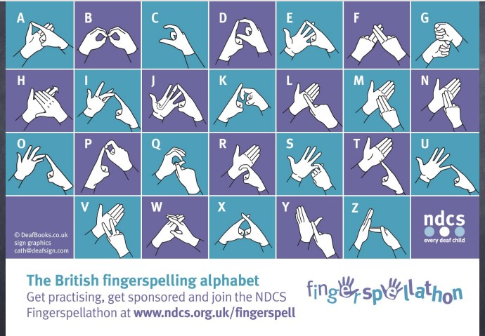

Slide 6
Activity
Let’s spell our names using sign language.

Slide 12
https://www.youtube.com/watch?v=HeKMdhzFW-k&ab_channel=FamilyTickets

Slide 13
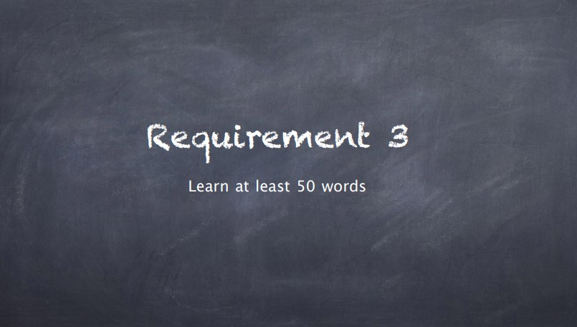

Slide 14
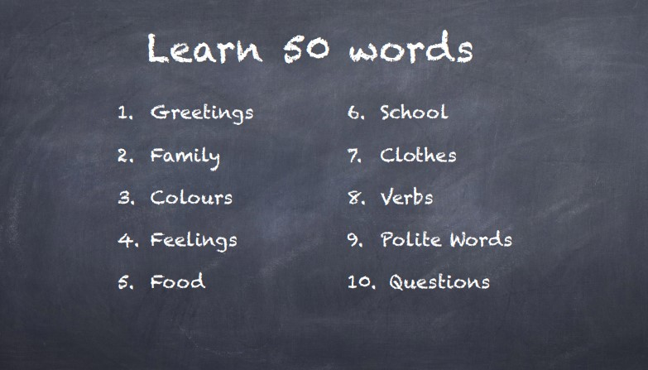

Slide 15
Makaton signs
1Mummy 9Water 17Bus 25to sleep 33 to wash
2Daddy 10Toilet 18 I 26to drink 34 to bathe
3Sister 11Bed 19me 27to eat 35 good
4Brother 12Chair 20you 28to look 36 bad
5Drink 13Table 21where 29 to see 37 yes
6Biscuit 14Shower 22what 30. to stand up 38 no
7Dinner 15House 23here 31 to get up 39 please
8Food 16Car 24there 32 to sit 40 thank you

Slide 16
Makaton signs
41, Good morning 49. milk
42. man 50, juice
43. lady
44. boy
45. girl
46. baby
47 bread
48. butter

Slide 17
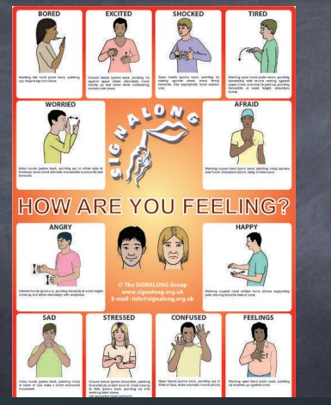
.youtube.com/watch?v=EfrJriE5Hwg&ab_channel=SingingHandsUK

Slide 19
Song: Jesus Loves Me
youtube.com/watch?v=_Sa-DxClTXw&ab_channel=CPHVBS

Slide 21
youtube.com/watch?v=eSx97D1k8Dg&ab_channel=WrightIdeaswithSusan
God sent our Lord Jesus Christ to make peace with us
Romans 5: 11

Slide 22
