Slide 1
Acts of Kindness Award
Juliette Steele
Florida Conference

Slide 2
Acts of Kindness
What does the Bible say?
What is Kindness and Love?
Do a skit about acts of kindness
Bible Stories
Kindness Craft
What can your Club do?

Slide 3
Bible Texts about
Acts of Kindness

Slide 4
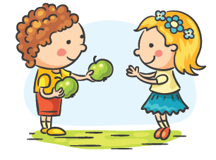
Romans 12: 10
Be devoted to one another in love. Honour one another above yourselves.

Slide 5
Proverbs 12:25
Anxiety weighs down the heart, but a kind word cheers it up.

Slide 6
How can we show kindness?
Put others first. Give comfort to others.
Complement others.
Show concern.
Love others.
Share with others.
Show your gratiitude.

Slide 7
What does the Bible say about kindness and love?
Love your neighbour as yourself. ( love)
Treat people as you would like to be treated ( Kindness)
Be kind to one another ( kind)
Love does not envy. ( love)
Love is patient. ( love)
Love is kind. ( love and kindness)

Slide 8
Bible Story Skit about Kindness!

Slide 9
Bible story pictures
Identify the Bible Story
State / Discover which act of kindness happened
OR
What unkind behaviour happened (And how it could have been different

Slide 10
A bible story of someone who showed love and kindness.
Loaves and Fishes

Slide 11
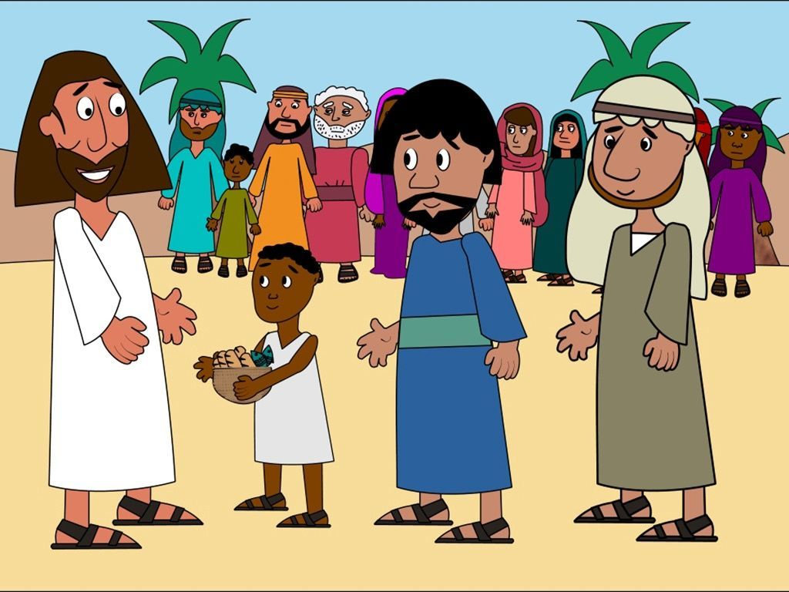
Which Bible Story is this?
Acts of Kindness or unkindness?

Slide 12
3 Bible stories about kindness
Zacchaeus- show video
Paralysed man- show video
Jesus heals the leper- show video

Slide 13
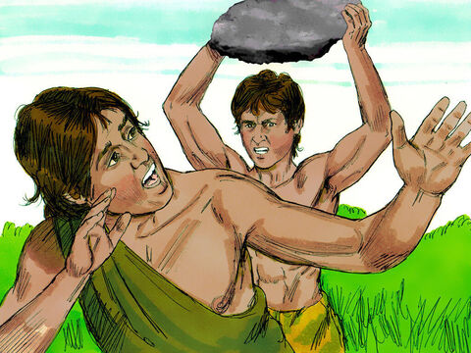
Which Bible Story is this?
Acts of Kindness or unkindness?

Slide 15
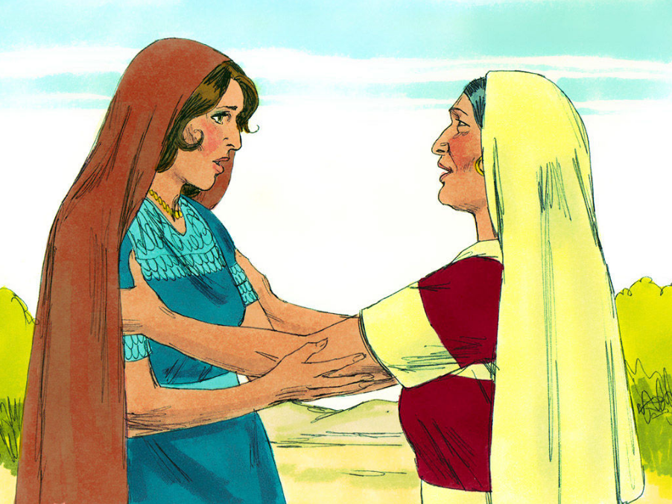
Which Bible Story is this?
Acts of Kindness or unkindness?

Slide 16
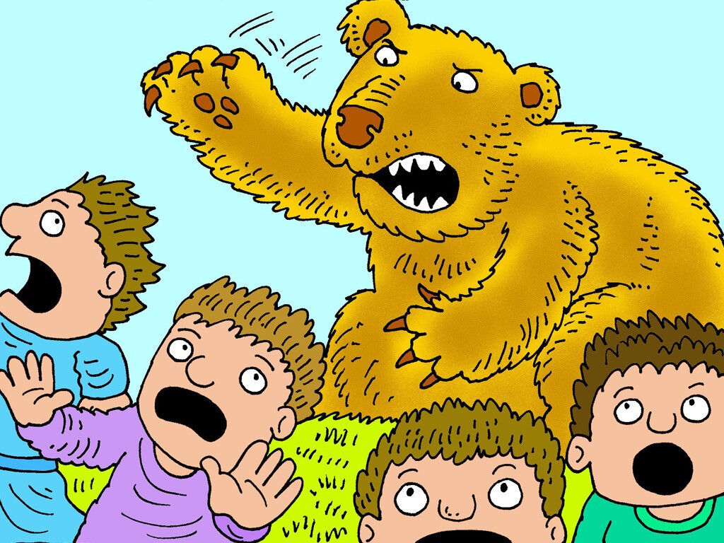
Which Bible Story is this?
Acts of Kindness or unkindness?

Slide 17
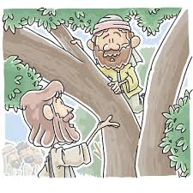
Which Bible Story is this?
Acts of Kindness or unkindness?

Slide 18
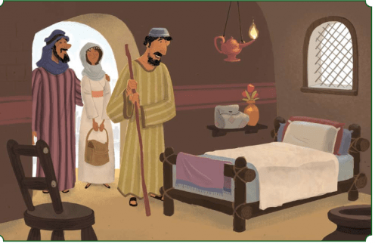
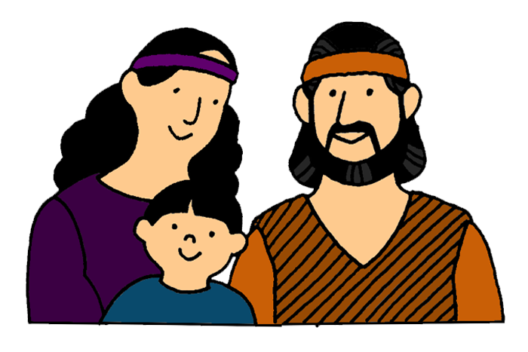
Which Bible Story is this?
Acts of Kindness or unkindness?

Slide 19
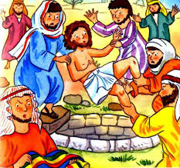
Which Bible Story is this?
Acts of Kindness or unkindness?

Slide 20
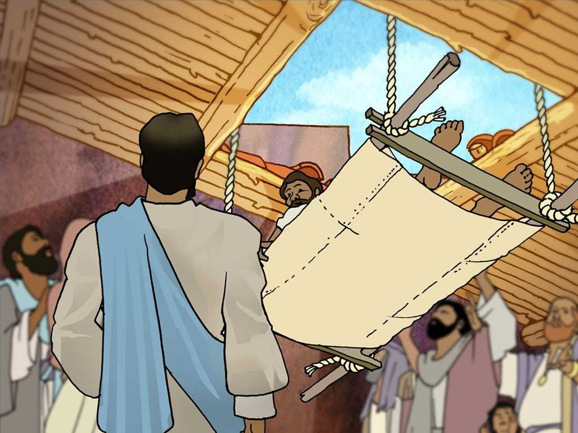
Which Bible Story is this?
Acts of Kindness or unkindness?

Slide 21
Craft
Kindness Paper Chain

Slide 22
Act of Kindness Brainstorm
We have given you a list of things you can do
Let’s go and be kind ☺

Slide 23
How can we show kindness as a club?
Give money.
Ask Aunty Cynthia what we can give as a club.
Help others.
Say thank you to our family.
Help your mum cook and do the chores.
Comfort your siblings when they are sad.

