Slide 1
Children of the Bible
E camp

Slide 2
Psalms 127: 3
Children are a gift from the LORD; they are a reward from him.NLT

Slide 3
1 John 3: 1-3
Behold, what manner of love the Father hath bestowed upon us, that we should be called the sons of God: therefore the world knoweth us not, because it knew him not.
Beloved, now are we the sons of God, and it doth not yet appear what we shall be: but we know that, when he shall appear, we shall be like him; for we shall see him as he is.³ And every man that hath this hope in him purifieth himself, even as he is pure.

Slide 4
Who was the 1st child born on Earth?
Genesis 4: 1
And Adam knew Eve his wife; and she conceived, and bare Cain, and said, I have gotten a man from the Lord.

Slide 5
What child heard God speaking to him while he was laying down in the Temple? 1 Sam 3: 1-11
¹⁰ And the Lord came, and stood, and called as at other times, Samuel, Samuel. Then Samuel answered, Speak; for thy servant heareth.

Slide 6
Which 3 children did the angels say would be born?
Jesus (Luke 1:28-38)
John the Baptist(Luke 1:8-17),
Samson(Judges 13:3-5)

Slide 7
Which child was taken from her family and became a missionary?
Little Maid.
Read her story in 2 Kings 5 to the children. Discuss how children can be a missionary in school and home.

Slide 8
How can you work for God?

Slide 9
Which child was raised by her cousin and grew up to be a queen?
Esther (Esther 2:7-18)

Slide 10
Which 2 children became kings when they were 7/8 years old?
Joash (2 Kings 11:21), Josiah (2 Kings 22)

Slide 11
What was Jesus like as a child?
obedient
helpful
kind
loving
(Luke 2:51, 52; Desire of Ages Ch 7; Messiah Ch 7)

Slide 12
How did Jesus treat children?
He showed them love and that he cared for them.
Luke 18:15-17; Mark 9:35-37

Slide 13
What advice did Paul give young Timothy?
Not to be intimidated that you are young and you should set a good example. 1 Timothy 4:12

Slide 14
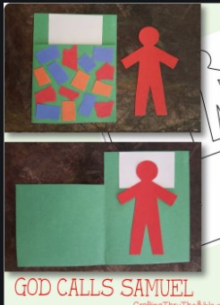
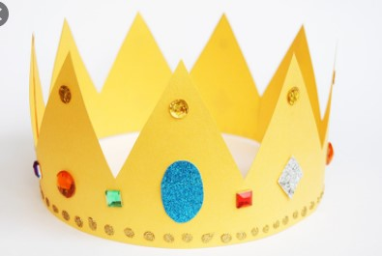
Craft Time

